Slide 1
Food marketing to youth: What’s the harm?
Introduction:
Facts about Food Marketing to Youth
Prepared by
Rudd Center for Food Policy & Health
Notes:
Parents may not realize how much food marketing influences what their children eat, and just how harmful this marketing can be. In this presentation, we discuss the connection between food marketing and our children’s diets and health.

Slide 2
Most children have poor diets
Notes:
Most children in America eat a poor diet. Nutrition experts say that no more than 10 percent of kids’ food intake should come from empty calories, which are calories from fat and added sugar.

Slide 3
They eat too many high-sugar high-fat foods
Most empty calories in kids’ diets come from:
desserts
pizza
fruit drinks
soda
Notes:
Unfortunately few children meet this recommendation. On average, children in America gets almost half of their calories from nutritionally poor foods, like desserts, pizza, fruit drinks and sugary soda.

Slide 4
And not enough fruits and vegetables
Notes:
Also, few children get the recommended five fruits and vegetables a day. Just four out of ten kids eat enough fruit, and fewer than one out of ten eat enough vegetables.

Slide 5
Poor diet leads to poor health in childhood…
One out of three children is overweight or obese
Type II diabetes used to be called adult onset diabetes.
Now, more than 5,000 youth are diagnosed annually.
Notes:
Eating like this leads to serious health problems. One in three youth is overweight or obese.
So many kids started developing Type 2 diabetes that they had to change the name from “adult onset” diabetes. Today, one in three cases of diabetes diagnosed in youth 10 to 19 years old are Type 2.

Slide 6
And lifelong consequences
Heart disease
Cancer
Strokes
Arthritis
Life-long obesity
Notes:
Health issues due to poor diet can follow children throughout their lives, often leading to heart disease, cancer, strokes, arthritis, kidney disease, and a lifetime of obesity and its associated health problems.

Slide 7
Children today may be the first generation to live SHORTER LIVES than their parents
Notes:
For the first time in history, we are raising a generation of children that are expected to live shorter lives than their parents.

Slide 8
So where does
marketing
fit into kids’ diets?
Notes:
So what place does food marketing have in a child’s diet?

Slide 9
The truth about food marketing
<1% fruits &vegetables
9% other foods
$1.8 billion
Spent per year on marketing aimed at children & teens
40% fast food
51% sugary drinks, sugary
cereals, sweets & snacks
Notes:
The food industry spends a massive amount of money—almost 2 billion dollars—to get kids to eat and drink more sugary drinks, sugary cereals, sweet and salty snacks, and fast food. Less than $10 million is spent marketing healthy foods like fruits and vegetables to kids.

Slide 10
The truth about food marketing
On average 13 TV ads
every day
Notes:
That kind of cash buys a lot of influence. On average, every child in the United States sees 13 TV ads for foods and beverages every day. This adds up…

Slide 11
Almost 5,000 ads every year on TV alone.
9 out of 10 for foods
high in sugar, salt and fat…
Notes:
Most kids see nearly 5,000 ads every year on TV alone. Nine out of ten of those ads are for junk food.

Slide 12
“Food marketing works” - Institute of Medicine
Watching food ads makes children
eat more
prefer and ask for advertised foods
consume more sugary drinks and fast food
Notes:
And the worst thing is.. These ads work.
Researchers have found that watching food ads makes children eat more, prefer and ask for foods they see advertised, and consume more sugary drinks and fast food.

Slide 13
Food marketers know how to get kids’ attention
Notes:
Food marketers spend a lot of time and money figuring out how to make kids love their products. They often use kids’ favorite TV and movie heroes to get kids’ attention and create an emotional bond.

Slide 14
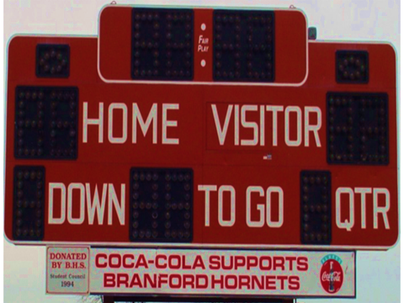
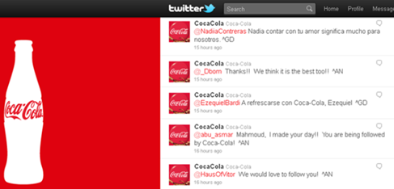
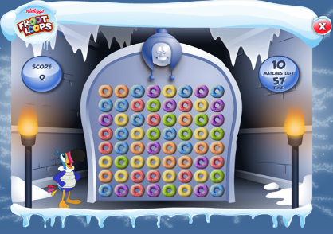
And they can reach children anytime, anywhere — often when parents aren’t looking
Notes:
They also reach kids in all sorts of places that parents may not even know about: using advertisements disguised as online video games, mobile phone applications and social media, prizes and giveaways, and even charities and sponsorships in schools.

Slide 15
Some communities get a “double dose” of marketing
Where children live, play and go to
school determines how much and what marketing they see
Notes:
Food marketers also specifically target low-income neighborhoods and Black and Latino kids. This means that some kids get a “double dose” of marketing – in the media and in their own neighborhoods.

Slide 16
Food marketers say they want to help parents raise healthy children
Children’s Food and Beverage Advertising Initiative
(CFBAI)
Foods like…
17 companies pledge to advertise only “better for you” foods in “child-directed” media
Notes:
Despite all this, food marketers claim that they want to help parents raise healthy children. The Children’s Food and Beverage Advertising Initiative is a pledge from 17 food companies to only advertise what they call “healthier dietary choices” to kids.
By their standards, healthier choices include crackers, popsicles, processed meals, fruit snacks, and sugary cereals. Missing from their lists are healthy foods like fruits and vegetables that children should actually be encouraged to eat more of.

Slide 17
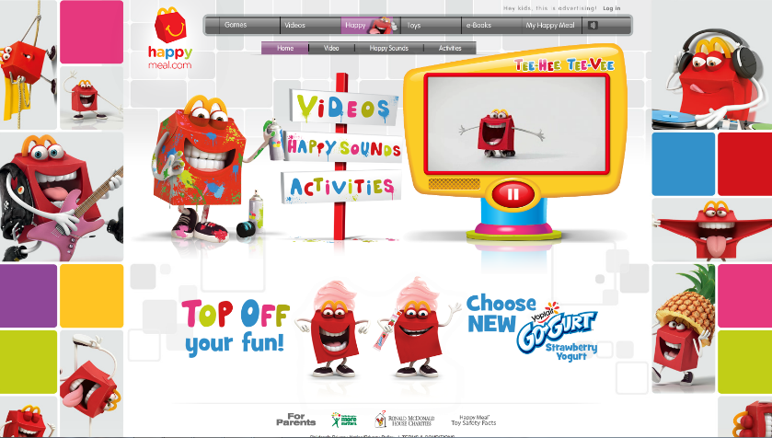
What else do they say?
Credit: Instituto Alana
Former McDonald’s CEO, Don Thompson:
“First off, we don’t sell junk food…”
“And we are not marketing food to kids.”
“We are not marketing in schools”
Notes:
Between the need to look like they’re trying to help parents, and the need to sell food to kids, these companies end up with a strange version of reality.
In a shareholder meeting in 2013 McDonald’s CEO Don Thompson said:
“First off, we don’t sell junk food.”
“And we are not marketing food to kids.”
“We are not marketing in schools.”
Ronald McDonald clearly didn’t get the memo about that one when he visits schools to teach kids about McDonald’s version of a “balanced lifestyle”.

Slide 18
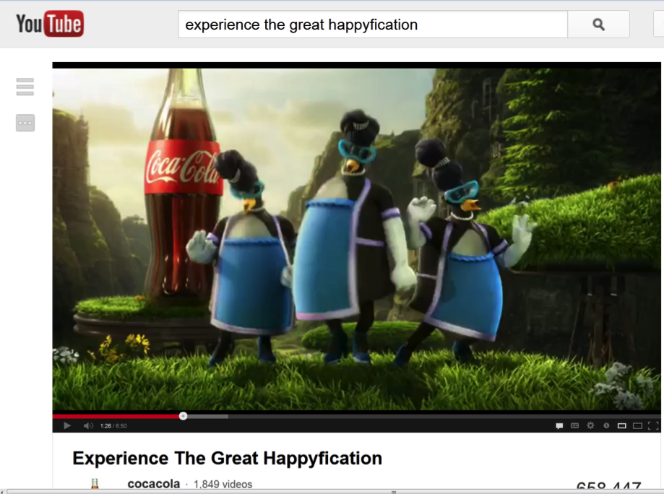
Or they don’t advertise to kids
Credit: Vienna City Marathon/Leo Hagan
“We commit to market responsibly, including no advertising to children under 12 anywhere in the world.”
-Coca-Cola’s pledge to help “beat obesity”
Notes:
Here’s another example. Coke seems to have a funny understanding of advertising to kids. Their definition of marketing probably doesn’t match most parents’

Slide 19
But targeting children is good for business…
“It isn’t enough to just advertise on television… You’ve got to reach kids throughout their day – in school, as they’re shopping at the mall… or the movies. You’ve got to become part of the fabric of their lives.”
- Corporate marketer Sharon Beder, quoted in the book Global Spin
They aren’t children so much as what I
like to call ‘evolving consumers.’”
- CEO of Prism Communications
“We’re relying on the kid to
pester the mom to buy the product,
rather than going straight to the mom.”
-Barbara Martino, advertising executive
Notes:
But it’s hard for companies to stop marketing to kids, because they know that even if it’s bad for kids, it’s great for business. The earlier they can reach kids, the more likely they will be able to create lifelong loyal customers for their brands. Even food marketers admit this:
One marketer said, “It isn’t enough to just advertise on television… You’ve got to reach kids throughout their day – in school, as they’re shopping at the mall… or the movies. You’ve got to become part of the fabric of their lives.”
Another calls children “evolving consumers”
And another advertising executive acknowledged their focus on children, saying: “We’re relying on the kid to pester the mom to buy the product, rather than going straight to the mom.”

Slide 20
What do parents think?
“[My kids] are bombarded. Every day, every minute.
The only time they are not bombarded with all these ads about food
is when they are sleeping. It is constant.”
-Concerned parent, Rudd Center interview
“You can’t control where they’re going to be and what they’re going to eat every minute. You can’t blame it all on the parents.”
-Concerned parent, Rudd Center interview
Notes:
What do parents think about all of this? In a focus group, one parent said ““[My kids] are bombarded. Every day, every minute. The only time they are not bombarded with all these ads about food is when they are sleeping. It is constant.”
Another said: “You can’t control where they’re going to be and what they’re going to eat every minute. You can’t blame it all on the parents.”

Slide 21
What can YOU do to reduce unhealthy food and beverage marketing to children?
Notes:
So what can YOU do to reduce unhealthy food and beverage marketing to children? There are ways to reduce the influence of unhealthy food marketing in your home, your child’s school, and in your community.

Slide 22
In your home
Talk
to your kids
Explain what advertisers are trying to do
Notes:
Talk to your kids about what marketers are trying to do. When your child asks for an advertised food, explain why you don’t want to buy it, and how the advertiser has spent a lot of money trying to convince your child that they must have this food.

Slide 23
In your home
Remove TVs, computers and other screens from bedrooms
Television in a child’s bedroom
Increases children’s screen time by about 1 hour per day
Increases children’s risk of overweight by 31%
Reduces time they spend reading, sleeping,
and on hobbies
Notes:
Remove the screens from your kids’ bedrooms.
Television in a child’s room increases their screen time by approximately 1 hour per day, increases the risk of becoming overweight by 31%, and reduces the amount of time kids spend reading, sleeping, and enjoying other hobbies.
And don’t forget to put their smartphone away at bedtime.

Slide 24
At school
Find out how much
food marketing your child sees in school
Look for:
Sales of branded junk food for fundraisers
Company-sponsored classroom materials
Logos on scoreboards, coolers and
sports equipment
Incentive programs for food purchases
Company-sponsored events
Notes:
See if you can find out how much food marketing in in your child’s school. You will probably be surprised.
Look for branded fundraisers, company-sponsored classroom materials, logos on scoreboards and sports equipment, incentive programs for food purchases, and company sponsored events.

Slide 25
At school
Promote HEALTHY fundraising
Such as:
Fruit baskets
Student art
Gift catalogues
Fitness “a-thon” events
Notes:
You can help limit unhealthy food marketing and raise money for school programs by promoting healthy fundraising with things like fruit baskets, student art sales, gift catalogs, and physical activity events, like walk-a-thons.
Many schools actually raise more money through walk-a-thons than they ever did from candy fundraisers.

Slide 26
At school
Join your school’s wellness committee!!
Learn more at RuddRootsParents.org
Notes:
Finally, you can get even more involved by joining your school’s wellness committee. This is where you can influence school-wide policies to improve school nutrition and limit unhealthy food marketing. After all, school should be a place that promotes children’s health rather than hurts it.

Slide 27
Want to do even more?
Learn more about unhealthy food marketing to kids.
Visit www.uconnruddcenter.org/food-marketing
Get Rudd Center news and updates on social media:
Join the Food Marketing Workgroup:
Network of 200+ organizations, individuals, and experts dedicated to eliminating harmful food marketing.
Visit www.foodmarketing.org
Notes:
For more information about unhealthy food marketing to kids, visit www.uconnruddcenter .org, or stay in touch through our social media channels.
You can also join the food marketing workgroup, a nation-wide network of organizations, individuals and experts dedicated to eliminating harmful food marketing. Visit www.foodmarketing.org.

Slide 28
In your community
Local Presenters: Use this slide to describe any local campaigns or initiatives that people can join to make a difference in their local communities
If you don’t have any such initiatives at present, feel free to delete this slide.
For ideas about local campaigns, visit our contact page at www.uconnruddcenter.org

Slide 29
“If we don’t get companies to know that we are unhappy…they are not going to change anything.”
-Concerned parent, Rudd Center interview
Notes:
However you decide to get involved, you can make a difference, and your contribution is important. As one parent said,
“If we don’t let companies know that we are unhappy, they are not going to change anything.”
Take action today. Make your voice heard. You can be part of that change, making sure kids can grow up in a world where healthy is easy, instead of the other way around.

Slide 30
Thank you!
www.UConnRuddCenter.org

