Slide 1
Feeding Scenarios: Toddlers (Ages 1-2)
February 2023

Slide 2
Allowing Children to Make Decisions
Ellyn Satter, RD states that there is a division of responsibility when feeding young children
The adult’s role is to serve nutritious foods in a safe and nurturing environment
The child’s role is to choose which food and how much of it they want to consume (within reason)
There are multiple advantages to children and care providers when serving meals family style (i.e., food and beverages are placed in common serving bowls, pitchers, containers on the table)

Slide 3
Feeding Toddlers
Transitioning from Bottle
Self-feeding
Choking Hazards
Food Jags
Child-led Food Discussions

Slide 4
Transitioning from Bottle
In general, infants may try drinking from a cup around 6 months of age and transition from a bottle around 12 to 18 months.
Signs a child may be ready to try drinking from a cup:
Sitting upright by themselves
Sealing their lip on the cup
Cups should not have lids.

Slide 5
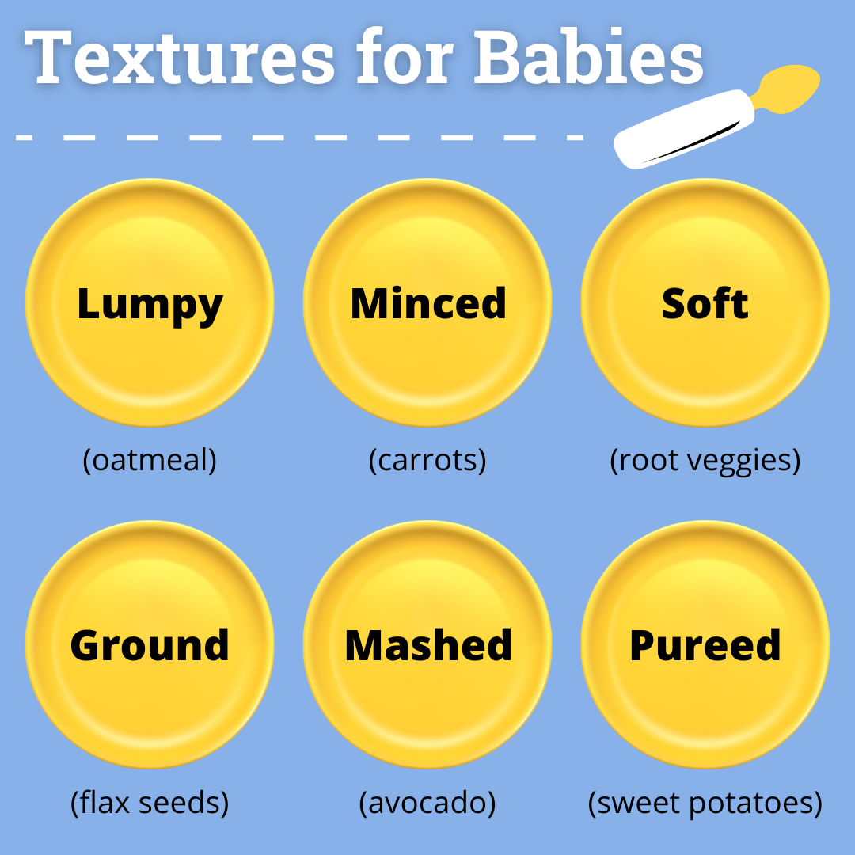

Slide 6
Transitioning to Table Foods
When the infant starts to grab at the spoon or try to pick up the foods themselves, they are ready for table foods
All foods should be soft and easy to grab
Foods like cheerios and puffs are good first finger foods, as they stick to wet hands and easily dissolve in the mouth
Children should always be fed while sitting in a high chair

Slide 7
Self-feeding
Children will start self-feeding by using their hands
You can begin introducing utensils after a child turns 1 year, but most children do not master the use of these until about 18 months
To avoid frustration, try giving a spoon with foods that will likely stay on the spoon if flipped over, like applesauce
Try to serve foods that are easy to scoop, like peas

Slide 8
A food jag is when a child will only eat the same food item, or a very small group of food items, prepared the same way every day for every meal
Keep offering a variety of foods, which could include different brands or flavors of the same item
Offer a “favorite food” alongside other foods
Try not to make a big deal of the behavior
Try not to use food as a reward or bribe
Remember your feeding roles – you provide good nutritious food, and the child decides whether to eat it or not and how much he/she wants to eat
Food
Jags

Slide 9
Toddler Eating Behaviors
Other common childhood eating behaviors may include fear of new foods and refusal to eat what is served
Some children will have aversions to certain foods. Continue to offer these foods in small quantities every few days
Children often need exposure to a new food 15 or more times before they will accept the food
Some children prefer only soft foods, or crunchy foods or avoid foods of different colors - this is normal toddler behavior

Slide 10
Choices
Giving a child a choice of 2 foods gives them some autonomy and pride in making a decision
The choices should be of equal nutritional value
“Do you want peas or green beans, pasta or rice, goldfish or saltines?”

Slide 11
Resources and References
Caring for Our Children National Standards Chapter 4: Nutrition and Food Service. 4.3. Requirements for Special Groups or Ages of Children: 4.3.2 Nutrition for Toddlers and Preschoolers: https://nrckids.org/CFOC/Database/4.3.2
American Academy of Pediatrics, Toddler Food and Feeding: https://www.aap.org/en/patient-care/healthy-active-living-for-families/toddler-food-and-feeding
USDA Provider Handbook for the Child and Adult Care Food Program, Supplement E: Support Family Style Meals: https://fns-prod.azureedge.us/sites/default/files/tn/Supplement_E.PDF
USDA, Offer Versus Serve and Family Style Meals in the CACFP, December 2016: https://fns-prod.azureedge.us/sites/default/files/cacfp/CACFP05-2017os.pdf
Institute of Child Nutrition, August 2022 Mealtime Memo: Choosy Eaters: https://theicn.org/may-2022-mealtime-memo-nutrition-education-for-young-children-6/
For more information on CACFP requirements please visit: https://portal.ct.gov/SDE/Nutrition/CACFP-Child-Care-Centers. Before implementing any changes to your program’s food and nutrition policies or practices, contact your CACFP representative to ensure you are meeting all rules and regulations.
Disclosure: The information in this module is based on a variety of sources listed above. It highlights key points relevant to this topic, but is not exhaustive. Please refer to the above resources for more information.

Slide 12
Thank You!
Made possible with funding from
the Centers for Disease Control and Prevention

